Slide 1
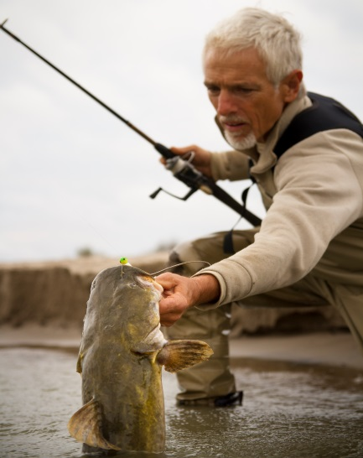
Aquatic Invasive Species in South Dakota
& Watercraft Inspection and Decontamination

Slide 2
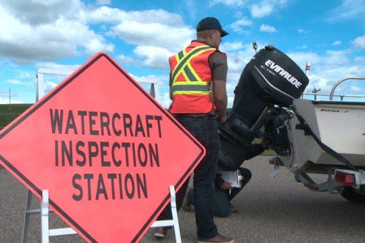
WID Process
Risk assessment (1-2 min)
High risk inspection (5 min)
Decontamination
Time is variable
Depends on type
Standing water vs. Full
www.montanaoutdoors.com

Slide 3
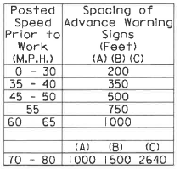
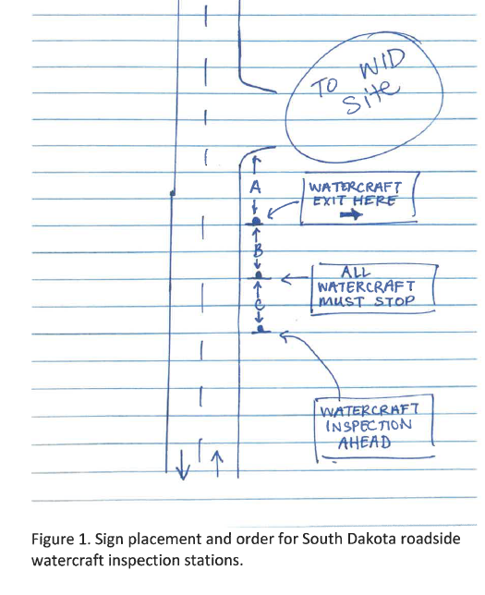
Initial Inspection
Entrance/Exit/Roadside
Roadside signage placement
Watercraft Inspection Ahead, All Watercraft Must Stop, Watercraft Exit Here

Slide 4
Initial Inspection
Risk assessment
Out of state/infested in past 30 days
Dirty/crusty/slimy
Standing water/ballast tanks
Complex (multiple motors, interior compartments)
If 2 or more risks occur, then conduct a more thorough, high-risk inspection
https://www.threeriversparks.org/page/aquatic-invasive-species

Slide 5
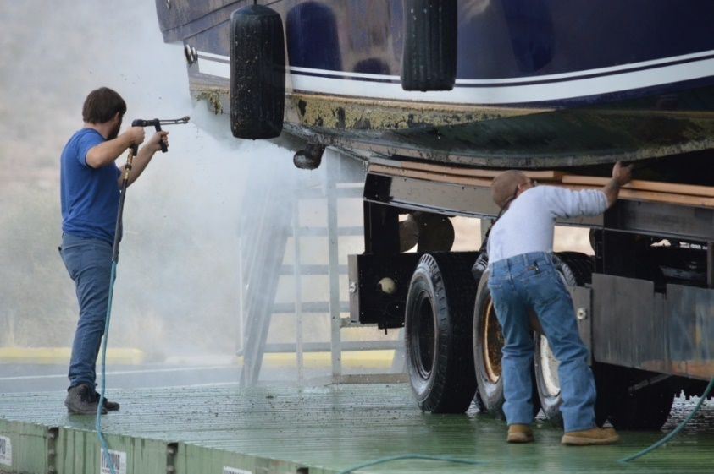
When is a Decontamination Required?
If water cannot be completely drained (ballast tanks) after leaving an infested water
If there is standing water in the watercraft
Observed AIS onboard

Slide 6
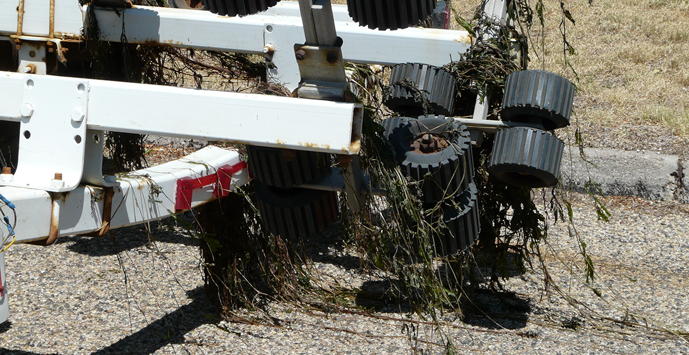
Types of Decontamination
Plant Decontamination
Simple – Manually remove all vegetation from trailer
If you cant remove vegetation – use 140 degree water for 15 seconds directly on plant matter

Slide 7
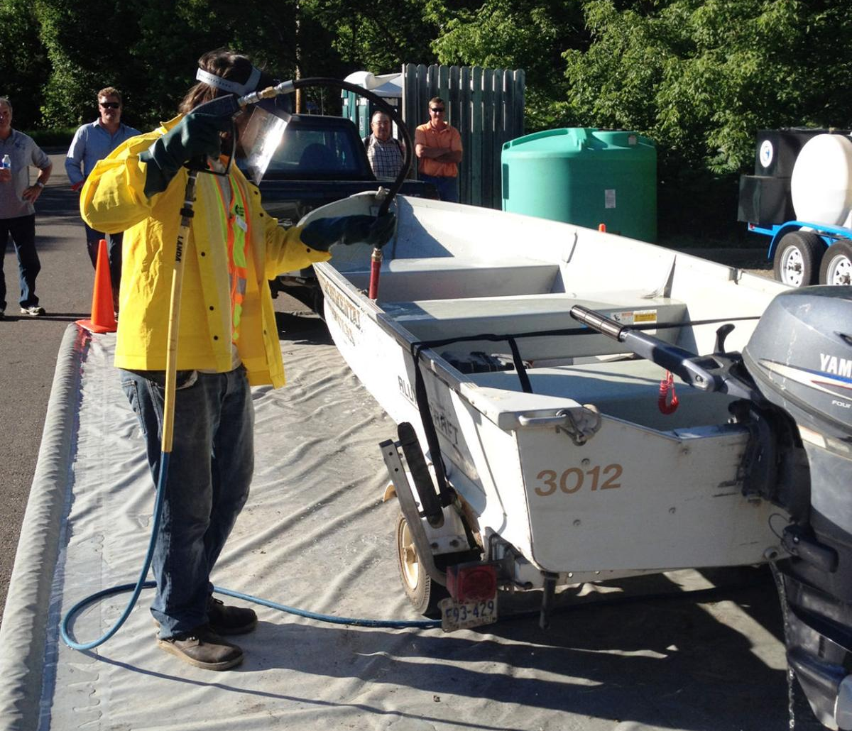
Types of Decontamination
Plant Decontamination
Standing Water Decontamination
Soak up water with sponge, chamois, or towel
Low-pressure rinse with 120°F water for 2 minutes
www.swnewsmedia.com

Slide 8
Types of Decontamination
Plant Decontamination
Standing Water Decontamination
Motor Flush
Jet Ski - https://www.youtube.com/watch?v=NsCcI5uXHkI
Skip forward to 1:13 – 4:08
www.swnewsmedia.com

Slide 9
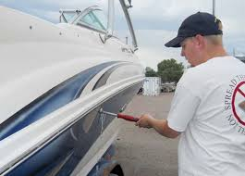
Types of Decontamination
Plant Decontamination
Standing Water Decontamination
Motor Flush
Ballast Tank Decontamination
Only needed if they come from an infested source
Low pressure flush with 120°F water for 5 min

Slide 10
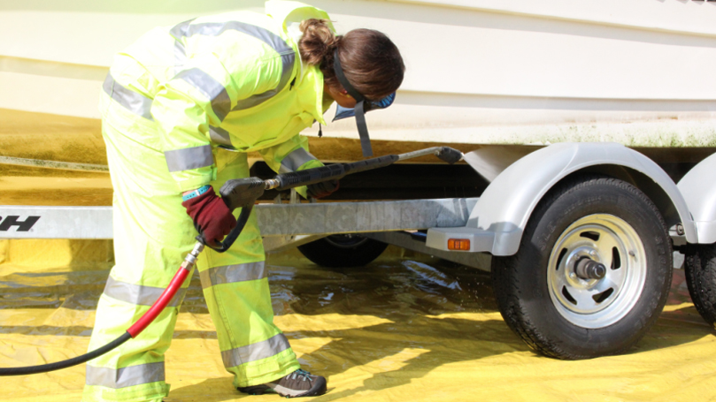
Types of Decontamination
Plant Decontamination
Standing Water Decontamination
Motor Flush
Ballast Tank Decontamination
Full Decontamination
If zebra mussels are observed on the boat or trailer
140°F water for 10 seconds on exterior surfaces, motor flush
120°F water for 2+ minutes on internal compartments

Slide 11
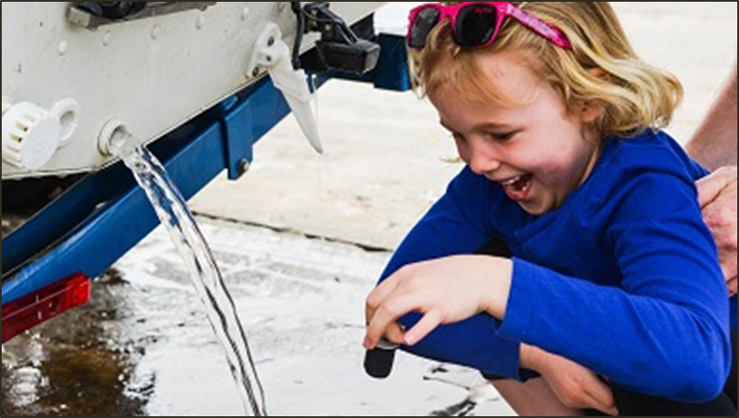
What’s the message?
CLEAN. DRAIN. DRY. Every time.
No mud, plants, or water moved among waterbodies

Slide 12
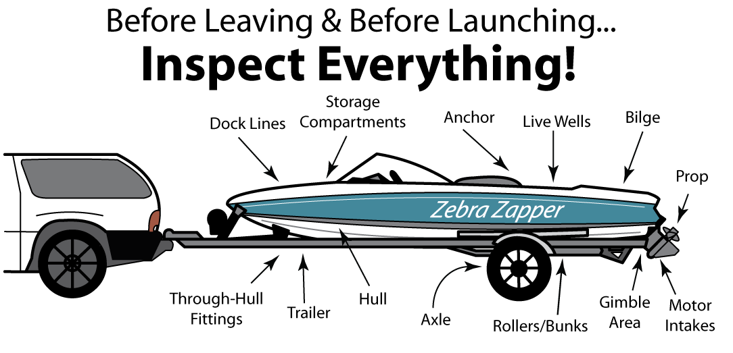
Watercraft 101
Notes:
You do not have to be an expert on boats to be a good ANS inspector. However, learning some basic boat anatomy and terminology is very important to be able to communicate with the boater and other inspectors, as well as help you intercept infested watercraft. In this section we will go over some common terminology, propulsion systems, three categories of boats, unique features and where to look for ANS.

Slide 13
Marine Propulsion Systems
Trolling Motors
Electric
Gasoline
Inboard/Outboard Engines (I/O)
Outboard Motors
Inboard Engines
Jet Engines
Notes:
There are several different types of propulsion systems that can be found on a watercraft. Everyone needs to know the definitions for each of the ones listed and differences between them.
Trolling motor can be electric or gasoline and are used for moving quietly and slowly through the water
Outboard motors are attached to the transom of the boat and are housed entirely outside of the boat
Inboard/Outboard or I/O engines have the lower unit outside of the boat while the engine is housed inside the boat.
Inboard engines have the entire engine located inside the boat with only a prop and prop shaft external to the boat
Jet engines intake water under the boat which is then forced through an impeller and out of the ‘jet’ that steers and powers the watercraft

Slide 14
Outboard
Outboard Motor
Anti-Cavitation
Plates
Gimbal Area
Prop
Through hull fitting
Transducer
Trim Tab
Drain Plug
Notes:
TRAINERS - Take the time to review each area named on the slide with the students and have them write them all down in their books.

Slide 15
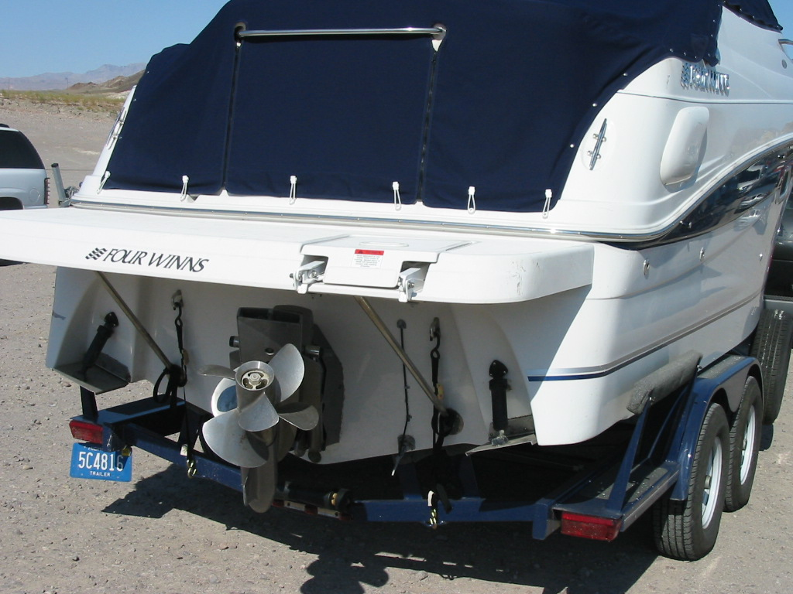
Inboard / Outboard
Through-Hull
Fittings
Bunks
Prop
Trim Tabs
Transducer
Bilge Drain Plug
Trailer
Notes:
TRAINERS - Take the time to review each area named on the slide with the students and have them write them all down in their books.

Slide 16
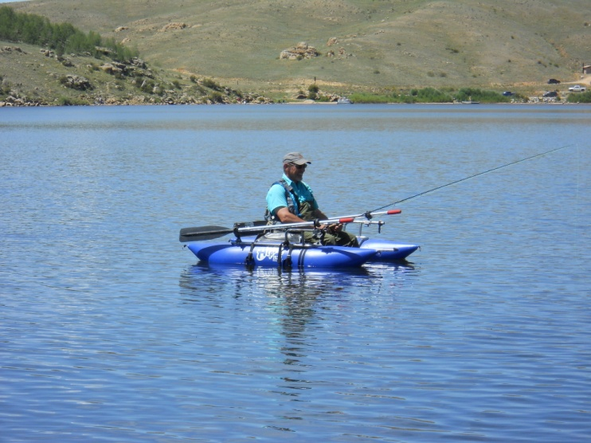
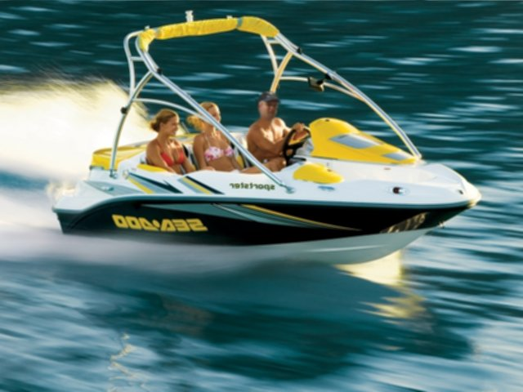
Watercraft Risk Assessment
Notes:
Not all boats pose the same risk of spreading ANS. In the next few slides we will talk about different types of boats and the risk that they could carry ANS.

Slide 17
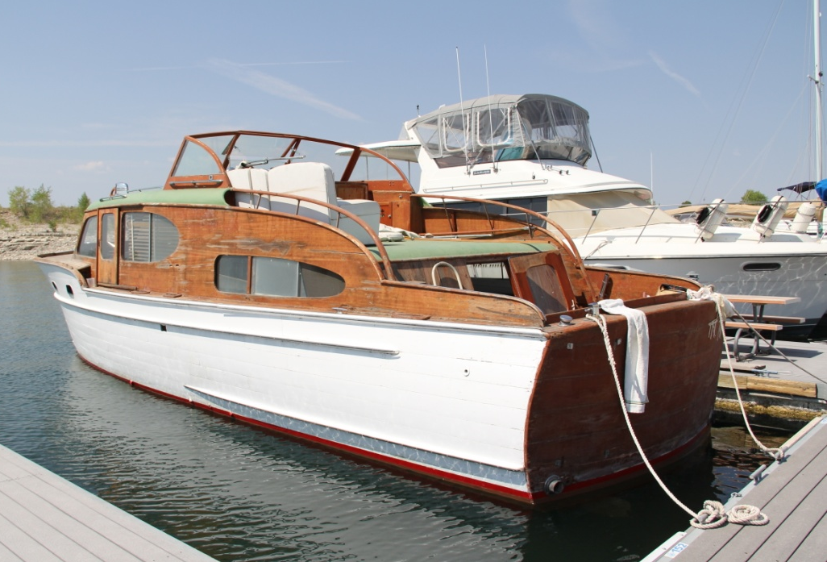
Categories of Boats
Hand-launched, non-motorized watercraft
Inspections may, or may not, be required pending state or local laws and regulations
Simple Boats
Need to inspect
Complex Boats
Need to inspect
VERY COMPLEX
Notes:
There are generally there defined categories of boats:
Hand-launched (not launched from a trailer going into the water) and non-motorized watercraft.
Simple boats need to be inspected.
Complex boats need to be inspected.

Slide 18
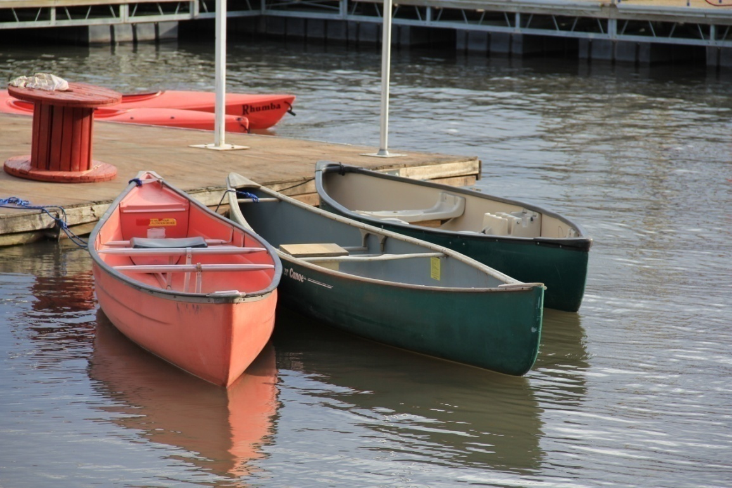
Hand Launched
Kayak
Canoe
Raft
Windsurfer and
Paddle Boards
Sailboard
Float Tubes
Inner Tubes
Notes:
The eight boats exempt in regulation from inspection in Colorado are:
Kayaks
Canoes
Rafts
Belly boats
Windsurfer boards and paddle boards
Sailboards
Float tubes and
Inner tubes

Slide 19
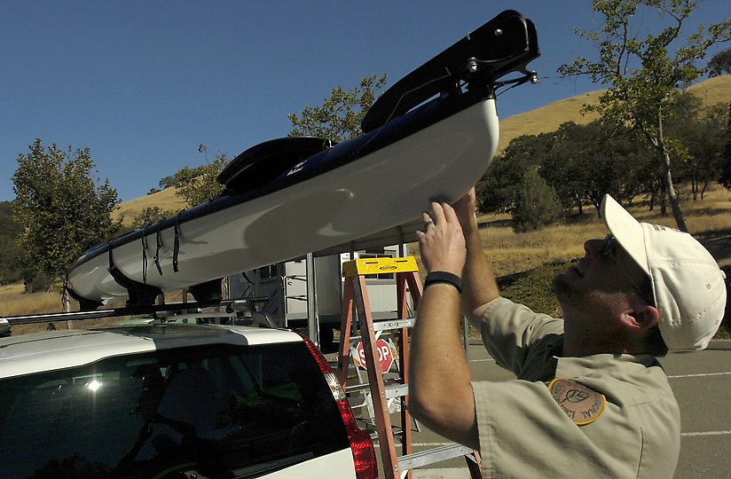
Hand-Launched:
No Trailer
No Compartments
No Motors or Engines
Typically Cleaned,
Drained & Dried
Notes:
Exempt boats generally pose very low risk of carrying ANS. The following reasons make them very low risk:
Hand launched
No compartments
Typically no motors or engines
Typically do not stay still or anchor
Typically do not stay long on the water
Typically dry quickly
Allows access when inspectors aren’t present

Slide 20
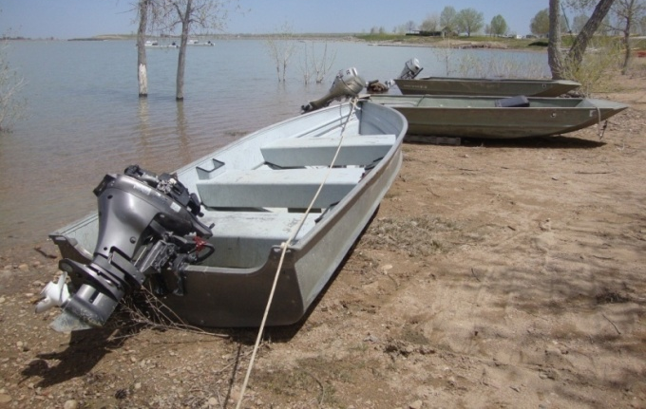
A Simple Boat
Open Hull
AND
No Containers or Compartments
AND
Single Outboard or Motor
Notes:
Simple boats generally pose a lower risk of risk of transporting ANS. Simple boats are defined as having an open hull, AND no containers or compartments, AND a single outboard motor.

Slide 21
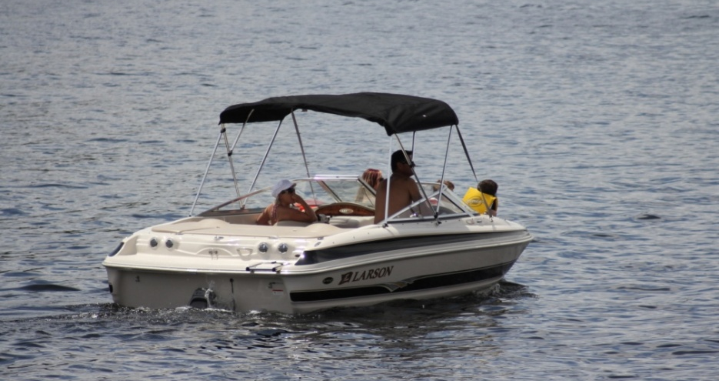
A Complex Boat
Closed Hull
OR
One or More Interior Compartments
OR
More Than One Motor or Engine
Notes:
Complex boats can pose a moderate to very high risk of carrying ANS. Complex boats are defined as having closed hull, OR one or more compartments, OR more than one motor or engine. If one of those three things is true – the boat is complex.

Slide 22
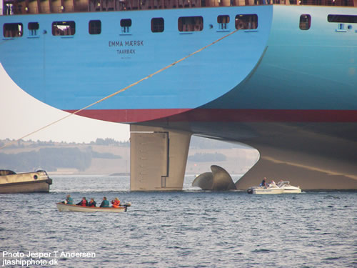
VERY Complex
Multiple Intakes
Multiple Devices
Multiple Engines

Slide 23
Watercraft Risk
Watercraft Type | Risk Level
House Boats, Cabin Cruisers Ski Boats and Wakeboard Boats with Ballast Tanks | Very High Biological Risk
Large Open Boats, Sailboats, Ski Boats and Wakeboard Boats with no ballast tanks, Personal Watercraft (PWC) | Medium to High Biological Risk
Simple Boats - Open Hull, Single Motors, No Interior Containers or Compartments | Low Biological Risk
Hand-launched, Non-Motorized Watercraft: Canoe, Kayak, Windsurfer Board, Paddle Board, Sail Board, Belly Boats, Rafts, Float Tubes and Inner Tubes | Very Low Biological Risk
Notes:
As you can see, the more complex the watercraft and the greater ability to carry water (ballast), the risk increases.

Slide 24
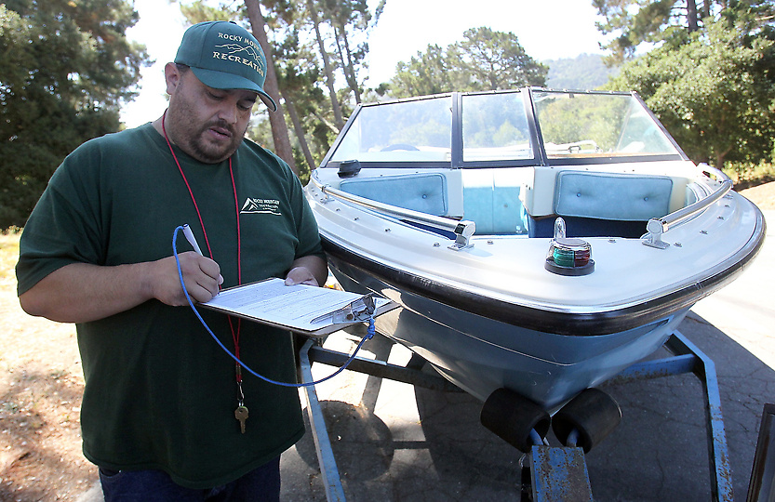
Boat Anatomy
Where Do We Look?
Notes:
Learning boat anatomy will help you learn where to look on a boat and how to describe the area if you find ANS. This is important to communicate with other inspectors, your supervisors and for paperwork.

Slide 25
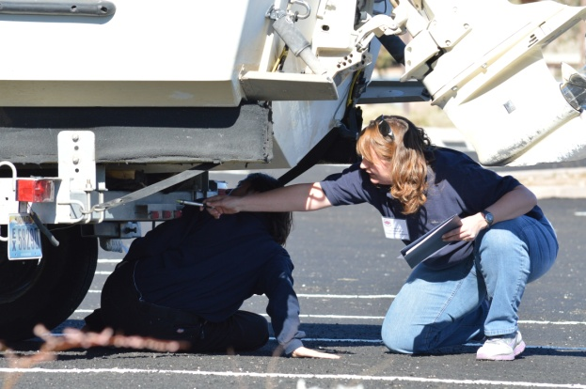
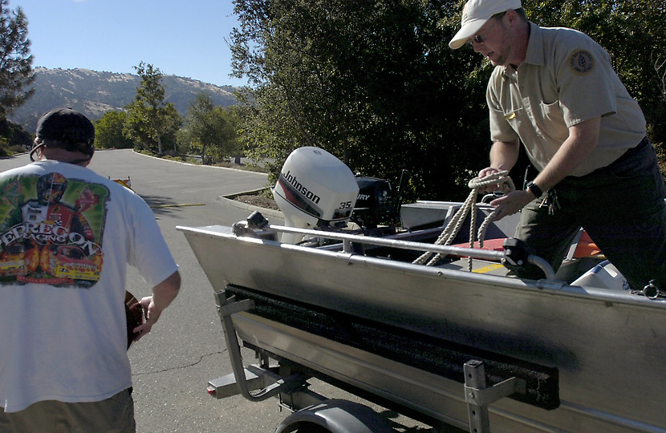
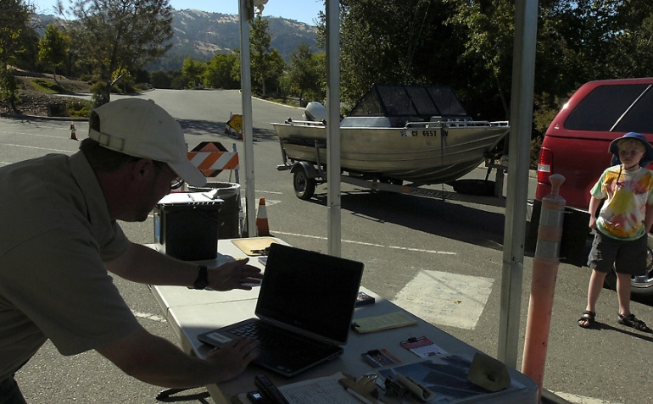
H.E.A.D.
H – Hull and Trailer – Exterior
E – Engine or Motor – Transom
A – Anchor, Anchor Rope and Equipment
D – Drain Interior Compartments
Notes:
The H.E.A.D. acronym suggested by an inspector to help others remember the inspection procedure. It worked so well, we adopted it!
H- Hull and Trailer, or exterior
E- Engine or Motor and transom
A- Anchor, Anchor line and equipment, and
D- Drain interior compartments

Slide 26
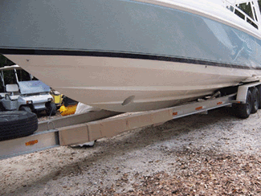
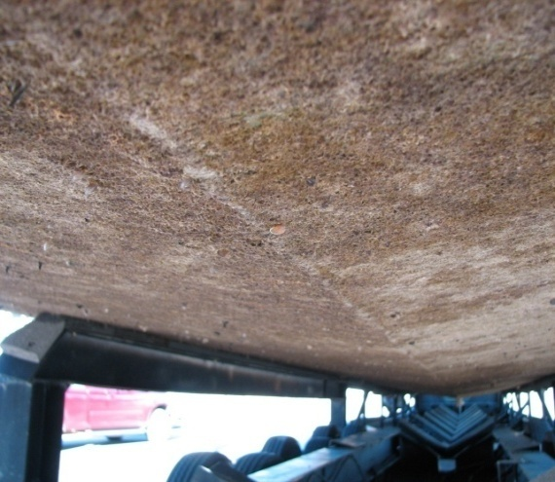
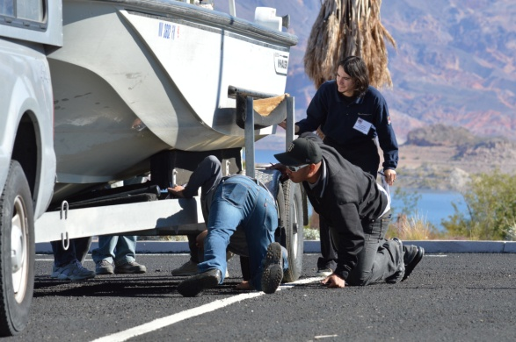
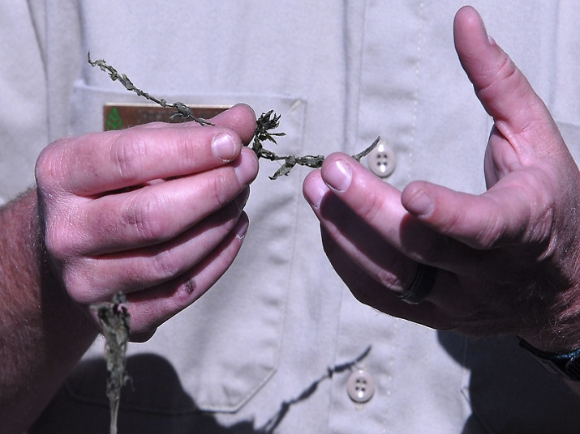
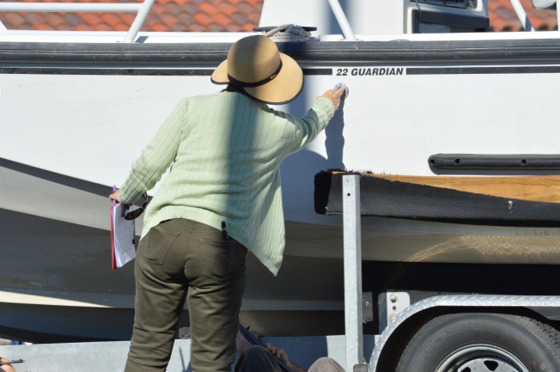
The Hull!
Notes:
The hull is the exterior, body of the boat. You need to look as well as feel with your hands when inspecting the hull and trailer.

Slide 27
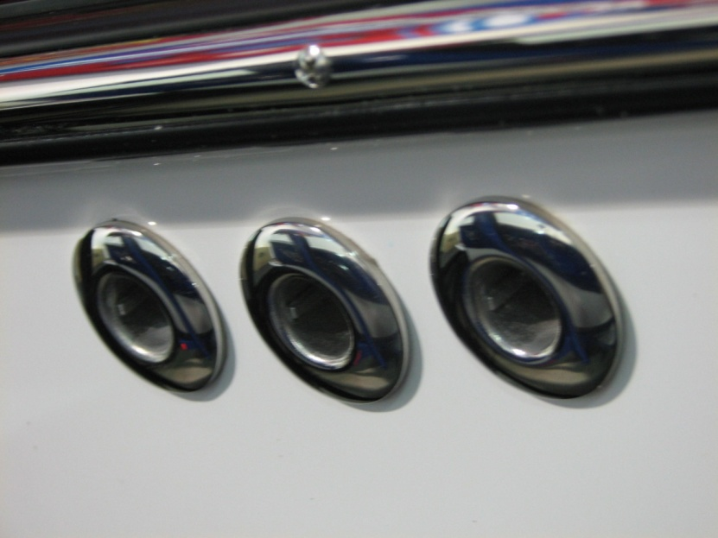
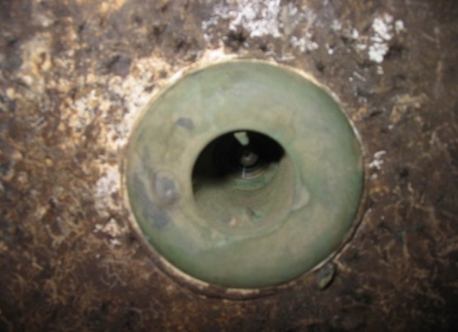
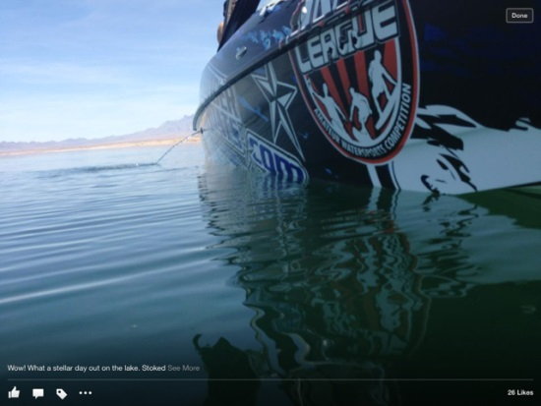
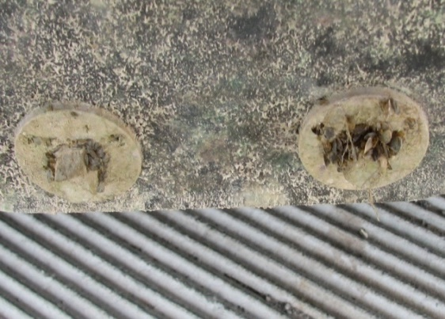
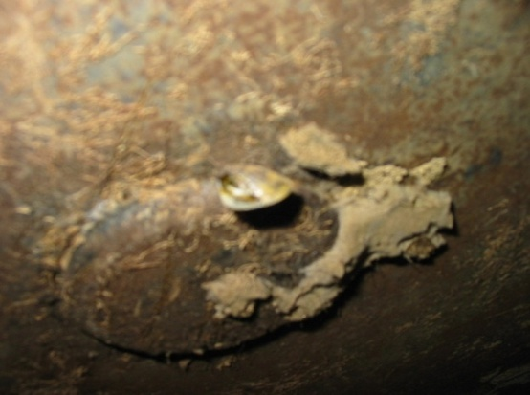
Through Hull Fittings
Use a flashlight!
Notes:
There are many different types of through hull fittings on the hull. Look carefully with a flashlight, particularly at those below the water line.

